Slide 1
Intro to mobile development

Slide 2
Mobile Development
Mobile application development is the process of making software for smartphones, tablets and digital assistants, most commonly for the Android and iOS operating systems
Mobile Development
Native
Cross

Slide 3


Native vs cross-platform
Native
cross-platform
Performance
Size
Resources
multi platform
This is before Flutter
Notes:
According season
- UI - test UI -

Slide 4
Native vs Flutter
Native
Flutter
Performance
Size
Resources
multi platform
Notes:
According season
- UI - test UI -

Slide 5
How Flutter works
Everything in Flutter is a Widget
A widget is a key component of the user interface (UI) in Flutter
Text
widgets example:
Widget
Icon
Image
Notes:
According season
- UI - test UI -

Slide 6
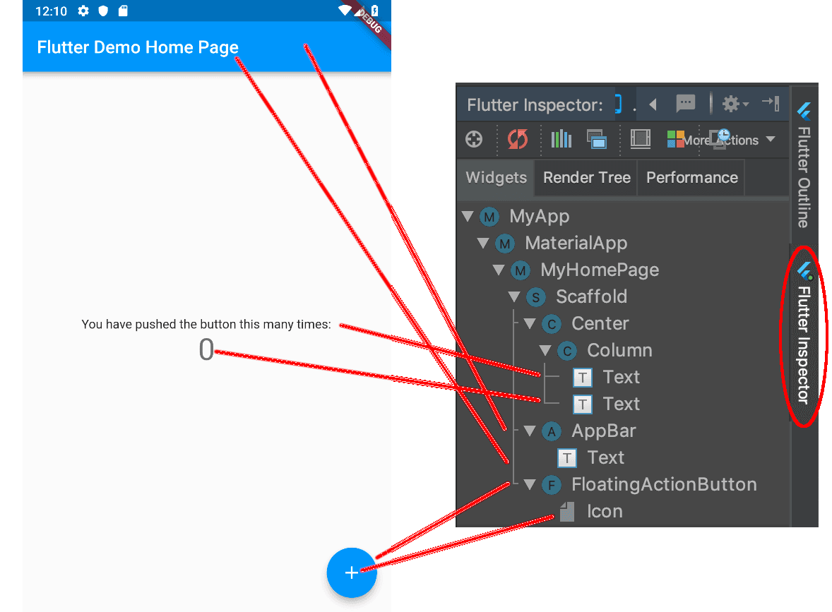
How Flutter works
Notes:
According season
- UI - test UI -

Slide 7
Dart Basics

Slide 8
Rules
We deal wit Mohsen
Good things give you Mohsens
Participate in session
Submit task
Absence of two meetings without a real excuse
(alert + affect on your Mohsens)
Notes:
According season
- UI - test UI -

Slide 9
Agenda
01
02
03
04
Data Types
Null safety
Functions & Parameters
Control Flow
05
OOP

Slide 10
01
Data Types

Slide 11
Note
In Dart, all types are reference types, meaning that all variables refer to an object (an instance of a class)
Notes:
types are more closely supported by the runtime system and have special rules or restrictions. These types are int, double, String, and bool, and they are sometimes called fundamental types or built-in types . These types are implemented to be immutable (unchanging) which means they behave as if they are value types
int x = 0;
int y = x;
x = 4;
print(y); //print 0 when you assign y = x, you are not copying the reference to the object that x refers to, but the value 0 itself.

Slide 12
Data types
String
bool
List
Map
Set

Slide 13
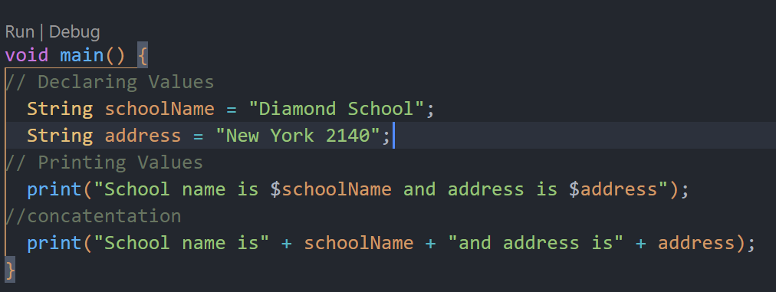
String
Notes:
void main() {
// Declaring Values
String schoolName = "Diamond School";
String address = "New York 2140";
// Printing Values
print("School name is $schoolName and address is $address");
//concatentation
print("School name is" + schoolName + "and address is" + address);
}

Slide 14
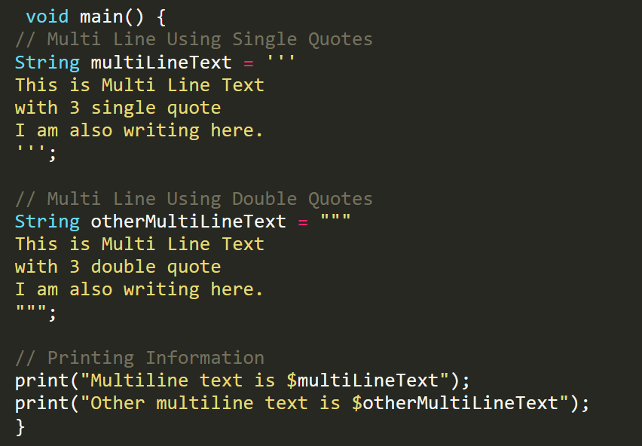
Multiple Line

Slide 15
Some String Methods
toLowerCase()
toUpperCase()
trim(): Returns the string without any leading and trailing whitespace.
compareTo()
split()
substring()

Slide 16
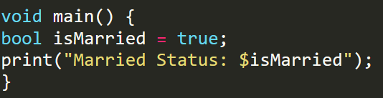
Boolean

Slide 17
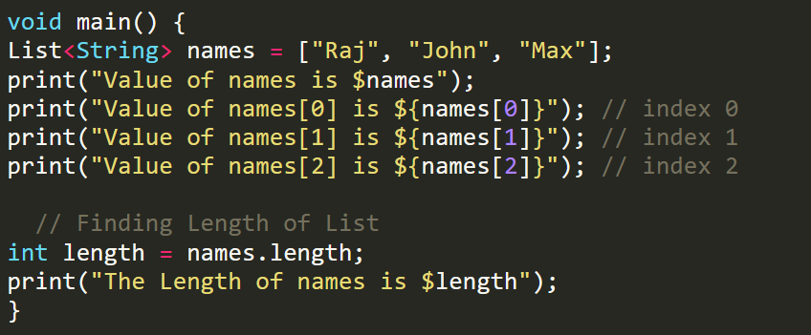
List
Notes:
void main() {
List<String> names = ["Raj", "John", "Max"];
print("Value of names is $names");
print("Value of names[0] is ${names[0]}"); // index 0
print("Value of names[1] is ${names[1]}"); // index 1
print("Value of names[2] is ${names[2]}"); // index 2
// Finding Length of List
int length = names.length;
print("The Length of names is $length");
}

Slide 18
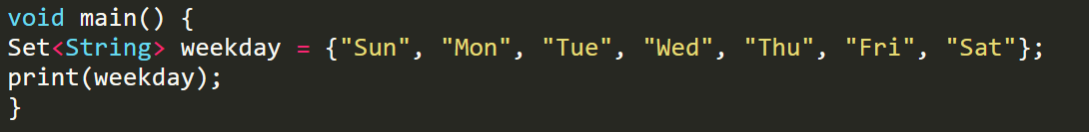
Set
Notes:
void main() {
Set<String> weekday = {"Sun", "Mon", "Tue", "Wed", "Thu", "Fri", "Sat"};
print(weekday);
}

Slide 19
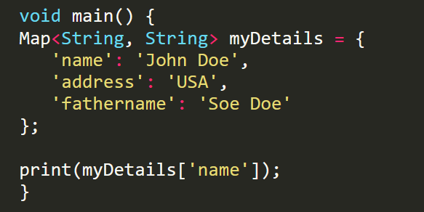
Map
Notes:
void main() {
Map<String, String> myDetails = {
'name': 'John Doe',
'address': 'USA',
'fathername': 'Soe Doe'
};
print(myDetails['name']);
}

Slide 20
var & dynamic
var
Type inference: automatically determining the type of a variable based on the value assigned to it.
dynamic
Dynamic typing : allowing a variable to hold any type of value at run time
Be careful when use dynamic
Notes:
void main() {
dynamic x = ‘amira';
x = 123;
print(x);
var a = ‘amira';
a = 123;
print(a);
}

Slide 21
Compile time error?
var member1;
member1="ahmed";
member1=10;
var member2="yousef";
member2=20;
ERROR!! Why?
Not ERROR

Slide 22
const & final
const
Value fixed in compile time
(must know this value once declare it)
final
Value fixed in runtime time
(can give the value after declare it)
Notes:
void main() {
const int c = 4;
final int f;
f = 3;
print(f);
print(c);
}

Slide 23
02
Null Safety

Slide 24
Meaning of null
a variable does not currently hold any meaningful value or does not refer to any object.

Slide 25
Null Safety
prevent null reference errors and makes code more reliable by ensuring that variables are non-nullable unless explicitly marked as nullable.
Notes:
This is a non-nullable field, must be initialized.
Note:
“any variable must be assign to value or make it nullable by ?”

Slide 26
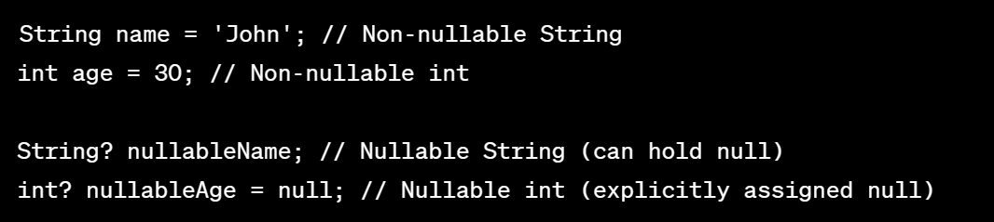
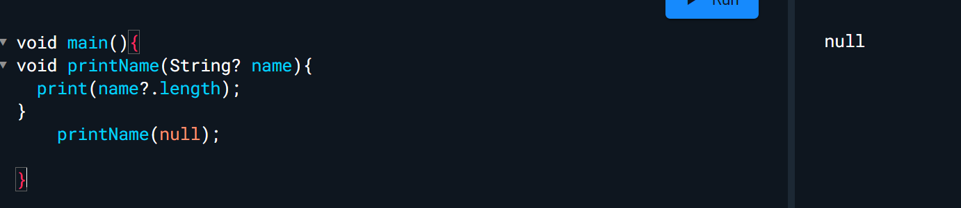
? Nullable Operator
?. Conditional Property access
Notes:
String name = 'John'; // Non-nullable String
int age = 30; // Non-nullable int
String? nullableName; // Nullable String (can hold null)
int? nullableAge = null; // Nullable int (explicitly assigned null)
----------------------------------
void printName(String? Name){
Print(name?.length);
}
printName(null);

Slide 27
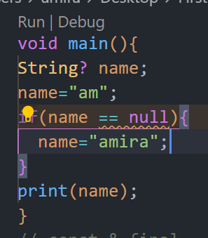
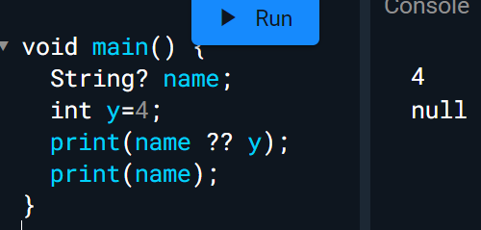
?? null-aware operator
expression1 ?? Expression2
If expression1 is null , do expression 2

Slide 28
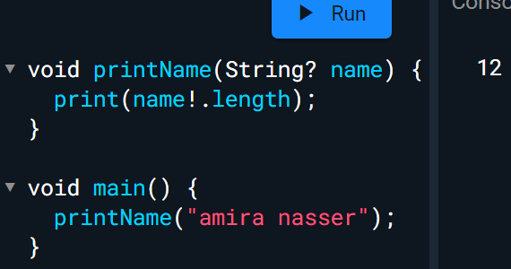
! Assertion Operator
You are asserting that it is non-null. or You promise to the compiler that it’s non-null.

Slide 29
03
Functions & Parameters
amira20nasser@gmail.com
LinkedIn
Amira Nasser | Facebook

Slide 30
Function
int lengthString (String name){
return name.length;
}
lengthString(String name)=> name.length;
isSuccess(int grade)=> grade > 50;
bool isSuccess(int grade){
return grade > 50;
}
void printName(String name ){
print("Your name is $name");
}
printName(String name)=>print("Your name is $name");

Slide 31
Types of Parameters
Required, positional parameters.
void greet(String name, int age) {
print("Hello ,$name Your age is $age");
}
Optional (nullable), positional parameters
void greet([String? name, int? age]) {
print("Hello ,$name Your age is $age");
}
Notes:
Required, positional parameters.
you must provide arguments for each required parameter in the same order as they are defined in the function signature. Required, positional parameters.
Optional(nullable), positional parameters
you must provide arguments for each required parameter in the same order. It’s not mandatory to pass the arguments between [].

Slide 32
Types of Parameters
Optional, named parameters
void greet({String? name, int? age}) {
print("Hello ,$name Your age is $age");
}
Named, optional & required parameters.
void greet({required String? name, required int? age}){
print("Hello ,$name Your age is $age");
}

Slide 33
04
Control Flow

Slide 34
If Condition
if(x==3){
print("x = 3");
}else{
print("not equal 3");
}
Shorthand Notation
(x==3) ? print("x = 3") : print("not equal 3");

Slide 35
Control Flow
for loops
while and do while loops
break and continue

Slide 36
Break & Continue
for (int i = 0; i < 5; i++) {
if (i == 3) {
break;
}
print("Hello");
}
for (int i = 0; i < 5; i++) {
if (i == 3) {
continue;
}
print("Hello");
}

Slide 37
05
OOP

Slide 38
Introduction to Object-Oriented Programming (OOP)
Object-Oriented Programming (OOP) is a programming paradigm that organizes data and behavior into objects, allowing for easier code maintenance and reusability. It emphasizes concepts such as encapsulation, inheritance, and polymorphism.

Slide 39
OOP Principles
1
2
3
4
Encapsulation
Inheritance
Share characteristics and behaviors between classes, enabling code reuse and creating hierarchical relationships.
Encapsulate related data and behaviors into objects, allowing for better organization and easier maintenance of code.
Abstraction
Polymorphism
Abstract complex systems into simplified models, hiding unnecessary details and providing a higher level of understanding.
Create flexible code that can take on different forms, allowing for variation in behavior based on object types.

Slide 40
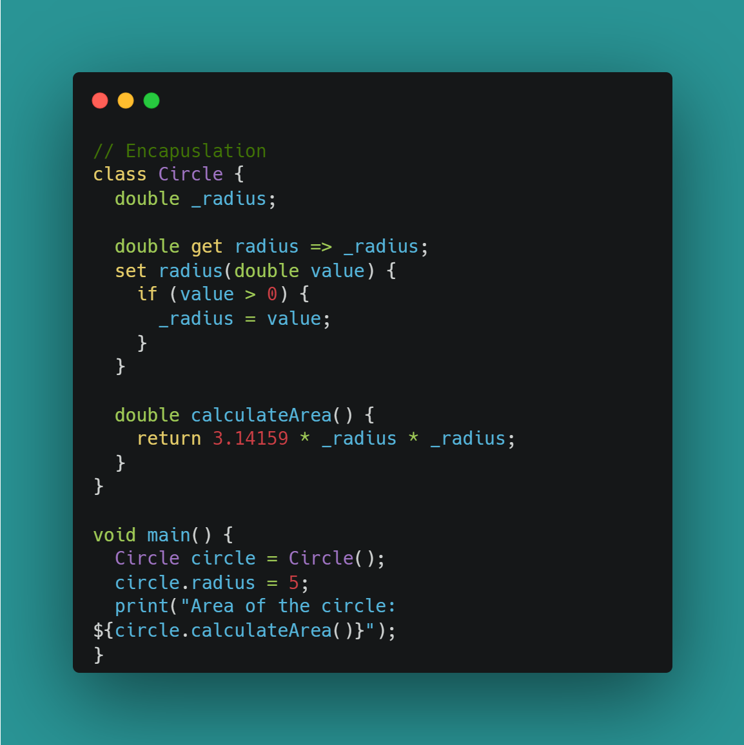
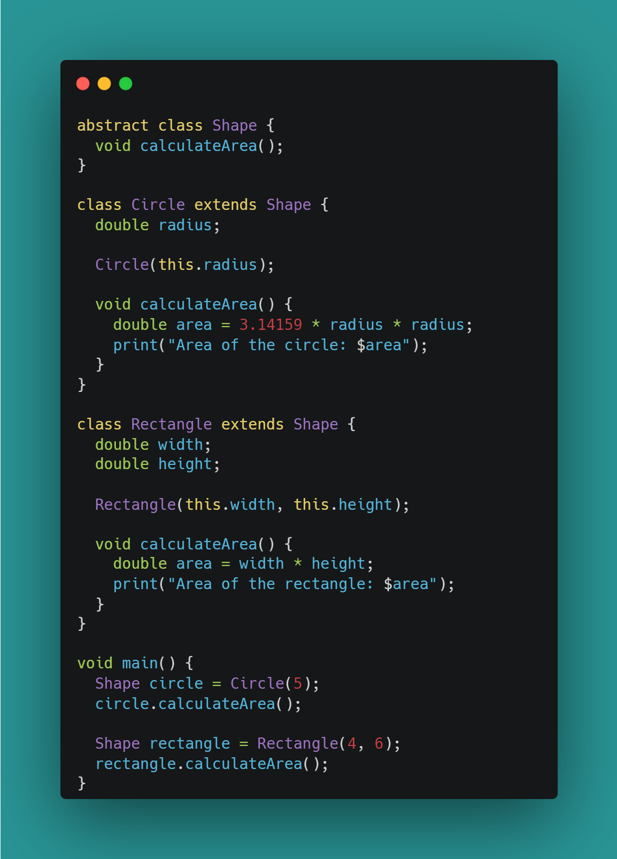
OOP Principles
1
Encapsulation
Abstract
2

Slide 41
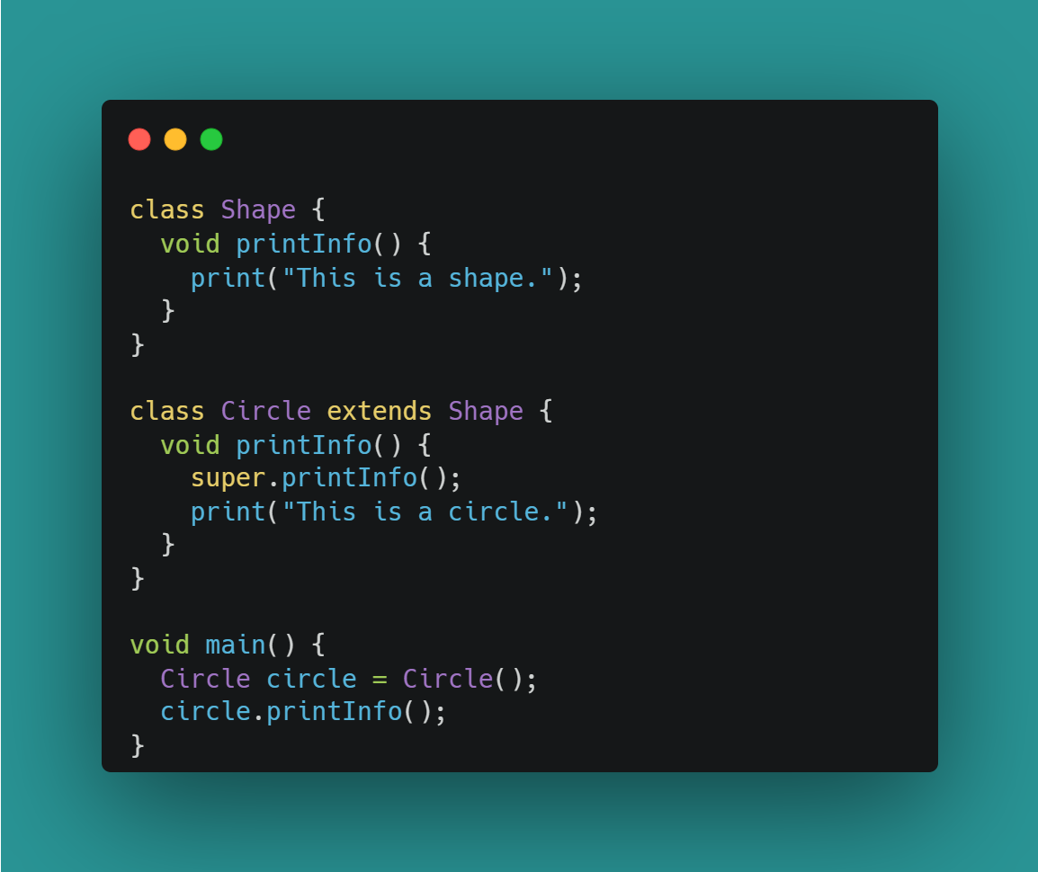
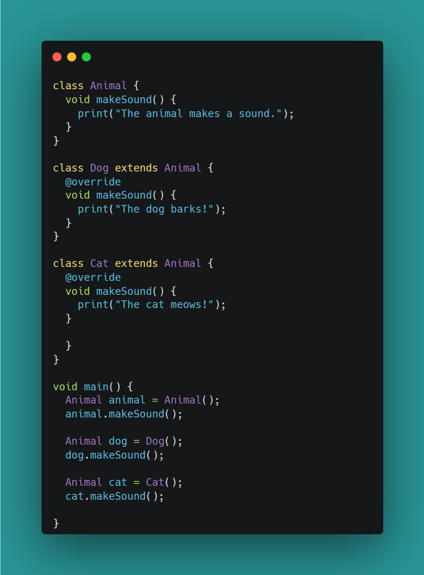
3
Inheritance
Polymorphism
4

Slide 42
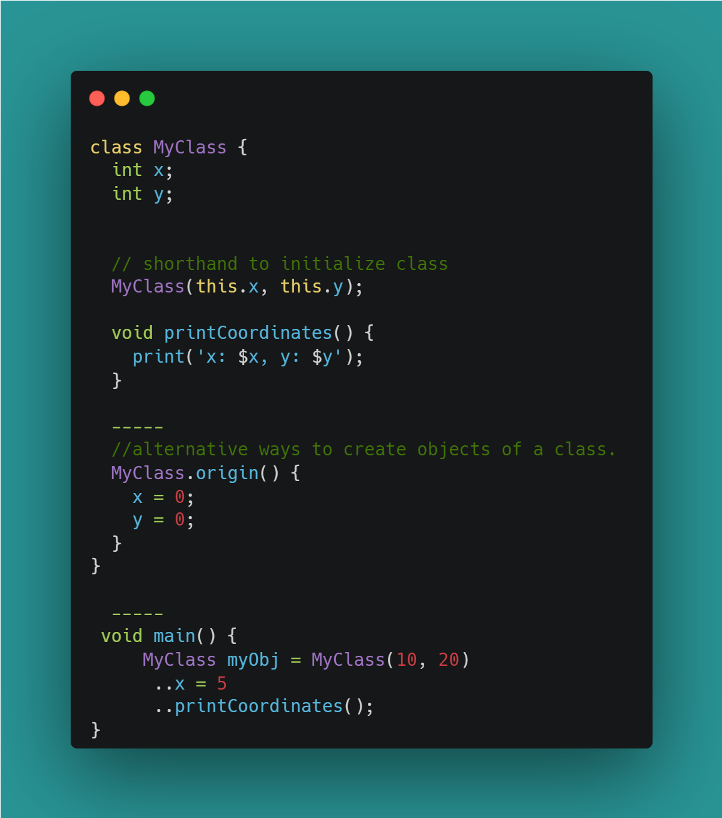
Some Shorthand notations in Dart

Slide 43
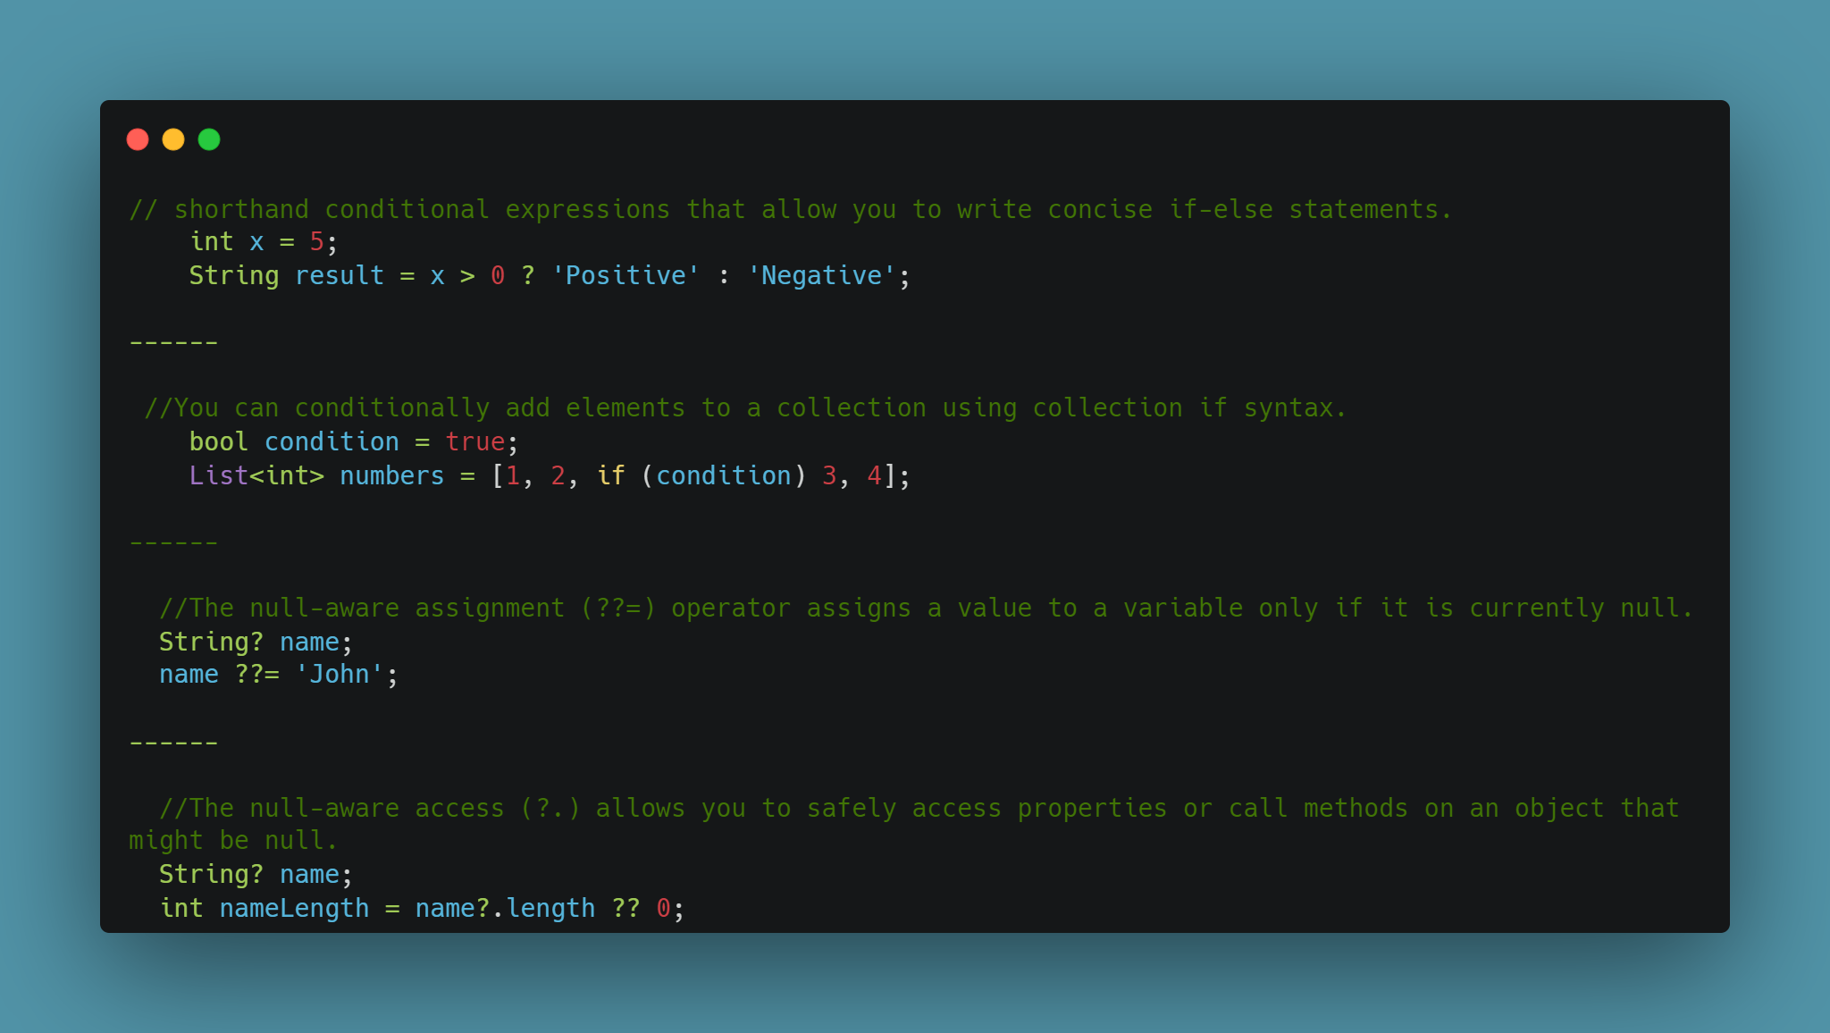

Slide 44
06
Asynchronous Programming

Slide 45
Future
In simple, future represent that data will be available after period of time (in future)

Slide 46
Asynchronous Programming
Don’t move from this part until execute this function
Notes:
Advanced Meaning: asynchronous operations are tasks that don't block the execution of the main thread, allowing the app to remain responsive.
Common examples of asynchronous operations include fetching data from a server, reading and writing files, and performing complex computations.

Slide 47
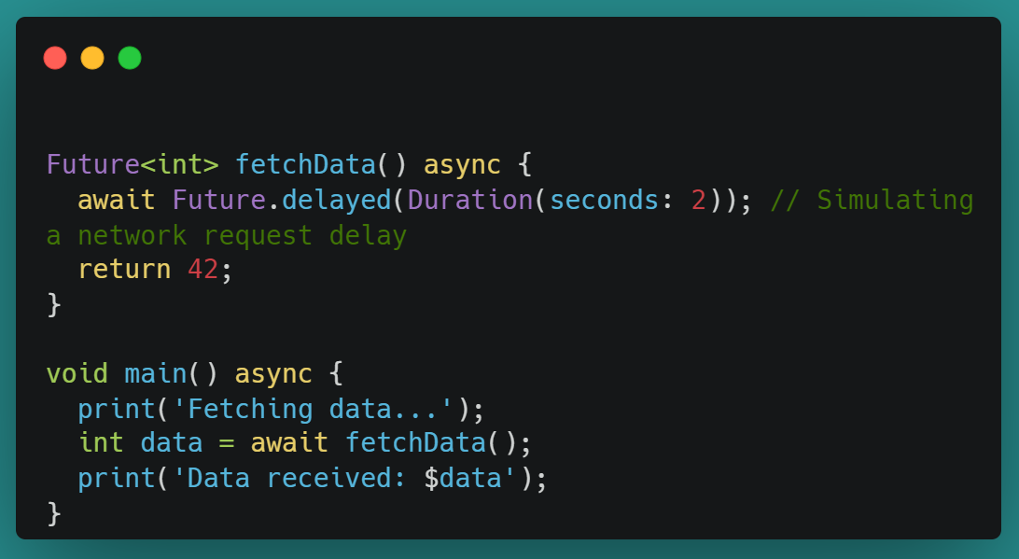
Asynchronous Programming

Slide 48
Thanks !
If you have any problem , send to me 😊

